Slide 1
A Low-Cost, Verifiable FPGA Resource for Embedded Machine-Learning Education in Open and Distance Learning
Wimalachandra R.D.M.K.T.
Department of Electrical and Information Engineering, University of Ruhuna, Galle, Sri Lanka
ICODE 2026 · International Conference on Open and Distance Learning
1
Notes:
[~30 s] Greeting and the single message. Good morning. My name is Wimalachandra, from the University of Ruhuna. My own background is FPGA design and embedded systems, not education research, so I'll speak as an engineer addressing educators, and I'll explain the hardware ideas in plain terms. The one sentence I want you to leave with: this work is not about building a better FPGA — it is an educational resource that lets distance learners carry out authentic embedded machine-learning experiments on hardware they own, and verify their own results. Pause, then advance.

Slide 2
Engineers must put models on real hardware — distance learners rarely can
▪ Modern curricula expect graduates to move a machine-learning model onto real silicon — training, numerical precision and digital logic together.
▪ This competence is built by doing, not by reading. You have to touch the hardware.
▪ In Open and Distance Learning (ODL), sustained laboratory access is the exception, not the rule.
For a distance learner,
hands-on hardware is the exception,
not the rule.
Embedded ML and hardware–software co-design are core skills — and they need real hardware.
2
Notes:
[~75 s] Lead with the competence, not the technology. Industry now expects an engineering graduate to take a trained model and run it on a real chip. That means holding three things in your head at once: how the model was trained, how numbers behave once you leave floating point, and how digital logic actually executes it. Emphasise: this is learned by doing. Now the problem for this audience — distance learners often never get sustained lab access. So the skill industry wants most is exactly the one hardest to deliver at a distance. Slow down on that sentence; it is the motivation for everything that follows. Transition: so what do we currently give distance learners, and why is it not enough?

Slide 3
Why existing options fall short for distance learners
▪ Remote and virtual labs genuinely help — but they are institution-owned and time-shared, leaving little room for free, exploratory tinkering.
▪ Pure simulation is cheap — but it never lets the student confirm a design on real silicon.
Modality | Cost / learner | Owned by student | Real silicon | Built-in verification
Campus lab (hands-on) | High | No (shared) | Yes | —
Simulation only | Low | No | No | No
Remote laboratory | Medium (institutional) | No (shared) | Yes | Limited
This resource | Low (≈ US$130) | Yes | Yes | Bit-exact
Table I — No existing modality offers low cost, ownership, real silicon and built-in verification together.
3
Notes:
[~80 s] Be fair to what exists before positioning your own work — reviewers and educators both respect that. Remote and virtual labs are a genuine advance, and the literature says they can match hands-on labs on many outcomes. But two limits remain. First, they are owned by the institution and shared through a booking system, so a learner cannot tinker freely late at night — and that exploratory tinkering is where deep understanding forms. Second, simulation removes the single most formative moment in hardware work: watching your design run on a physical chip. Now walk the table left to right, then rest on the final row: this resource is the only one that is at once low-cost, student-owned, on real silicon, and self-verifying. Point at the gold row. Transition: let me show you what that resource actually is.

Slide 4
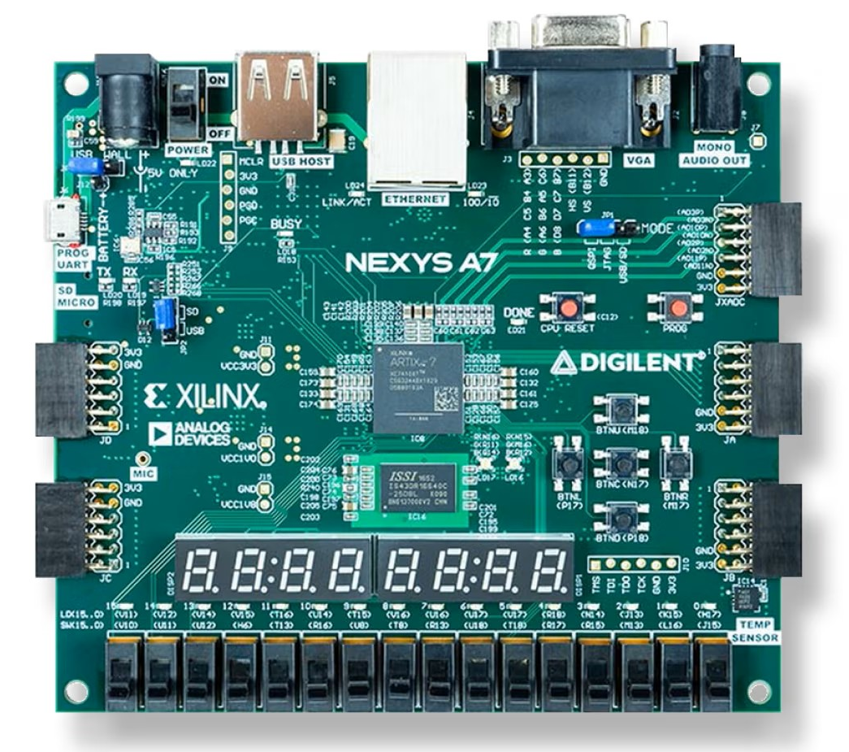
The proposed resource: a verifiable FPGA you own
Affordable & owned
– A commodity FPGA board (≈ US$130) with free vendor tools the learner owns it outright.
Full-stack in one project
– Training (machine learning) → fixed-point export (numerical methods) → RTL synthesis (digital design).
Verifiable by design
– An on-device self-test proves the hardware reproduces the software model, bit-for-bit.
Design-based research: an artifact built to be reproduced on a student's own desk.
Figure 1 — Nexys A7 AMD Xilinx Artix 7 FPGA (Mid range balanced performance FPGA)
4
Notes:
[~65 s] Three design principles, taken straight from the paper. One — affordability and ownership: about 130 US dollars, standard free tools, and crucially the student owns it. No booking, no queue. Two — full-stack transparency: one project spans three subjects we normally teach separately: the machine learning, the numerical methods of going to fixed point, and the digital design of turning that into hardware. Three, the heart — verifiability: the board can prove to the student that it behaves exactly like the software reference. Keep this at the level of 'a small, affordable computer you build that runs your model'; do not go into FPGA internals here. Transition: here is the pipeline that ties those three stages together.

Slide 5
One pipeline: from trained model to verified hardware
SOFTWARE DOMAIN
Train in PyTorch
15-stage LISTA denoiser
Quantize
float → fixed-point
(Q m.n)
Software golden model
exact integer outputs
On-device self-test
BIT-EXACT
equivalence check
same fixed-point
specification
Write RTL (Verilog)
Synthesize → run on FPGA
Nexys A7-100T
HARDWARE DOMAIN
✓ Verified hardware → live demo
A software reference and an on-device self-test confirm the hardware is exactly right — the same fixed-point specification drives both paths.
5
Notes:
[~90 s] Walk the flow, do not read the boxes. Top row is software: we train a small denoiser in PyTorch, then quantise it — convert it from floating point to fixed-point integers, because that is what cheap hardware runs. From that fixed-point description we do two things. Going right, we build a software 'golden model' that computes the exact integer answer. Going down, the same specification becomes hardware: we write it in Verilog, synthesise it, and run it on the FPGA. Then the two paths meet at the box on the right — the on-device self-test — which checks the hardware output against the golden model, bit for bit. If they match, the hardware is verified and we run the live demo. The key word is 'same specification driving both paths' — that is what makes an exact comparison meaningful. Transition: that comparison is the real contribution, so let me slow down on it.

Slide 6
Bit-exact verification — the heart of the idea
A software “golden model” computes the exact integer result the hardware should produce.
Software golden model
exact integer result
✓ MATCH
The hardware is faithful. Correctness becomes a verified learning outcome.
Compare
bit-for-bit
FPGA output
on real silicon
✗ MISMATCH
The gap points to the concept to revisit:
numerical precision
timing
interface
The feedback a tutor would give in person.
Correctness becomes something the learner proves — not something a lecturer asserts. Debugging turns into guided learning.
6
Notes:
[~105 s] This is the slide to expect questions on, so take your time. Technically: because the design is fixed-point, it is fully deterministic — for a given input there is one exact integer answer. So we can compute that answer in software (the golden model) and compare it against what the chip produces, bit for bit, with no tolerance. Educationally: a match is positive proof the student's hardware is faithful to the model — they are not taking the lecturer's word for it. A mismatch is even more useful: it localises the error to one of three concepts — numerical precision, timing, or interface — which is exactly the diagnostic a supervisor would give in person, delivered automatically on the student's own desk. Why better than simulation: simulation shows the model working in software; it never proves the physical chip is right. Here the proof is on real silicon. And this is why verification becomes a learning outcome, not just a QA step — the act of making the check pass is the learning. Be precise if asked: this proves the hardware faithfully matches the model; it does not claim the model itself is optimal. Transition: so why choose embedded machine learning as the thing to verify?

Slide 7
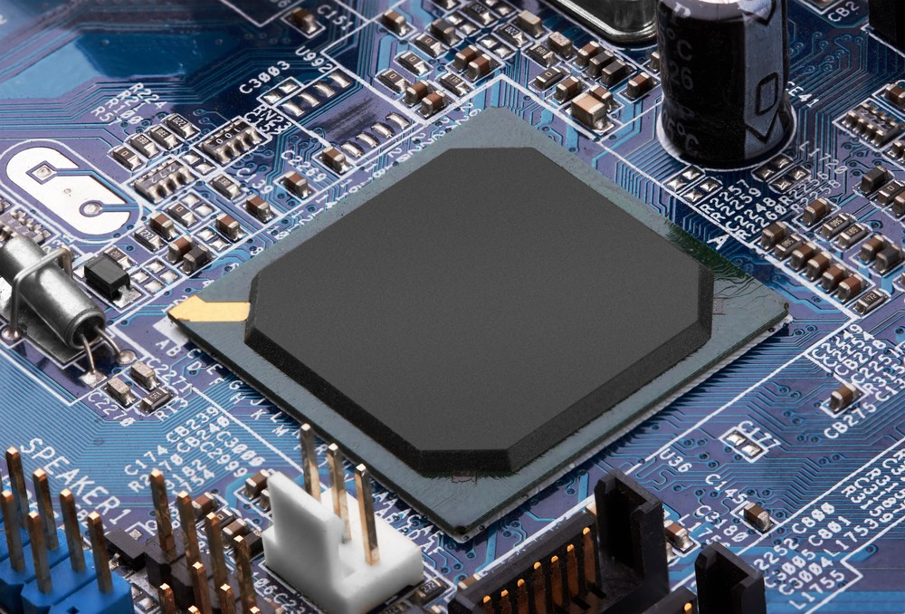
Why embedded machine learning is the demonstration
▪ The hard, integrative skill — one task spans training, numerical precision and digital logic at once.
▪ Hard to teach remotely — it needs real hardware and real timing, not just a simulator.
▪ FPGA fits — it exposes the register-transfer-level mapping that microcontroller TinyML hides.
▪ The chosen example — a 15-stage LISTA sparse-coding denoiser: compact and interpretable in hardware.
One board, two domains,
one identical datapath:
natural images + ECG signals
Denoising is a concrete task where 'better' is visible and measurable.
7
Notes:
[~75 s] Explain why this application, in plain terms. Embedded machine learning is the integrative skill: a single task forces the student to connect training, number representation, and digital logic — the very things distance study tends to teach in separate boxes. It is also genuinely hard to teach remotely, because it depends on real hardware behaviour and timing that a simulator does not reproduce. Why an FPGA and not a microcontroller: the popular TinyML route runs models on microcontrollers but hides the register-transfer level — the actual mapping of maths to logic — which is exactly what co-design students need to see; an FPGA exposes it. Finally, the specific model — a fifteen-stage LISTA denoiser — was chosen not because it is the most powerful, but because it is compact and maps cleanly and readably to hardware. And denoising is a task where improvement is directly visible. Transition: here it is, running.

Slide 8
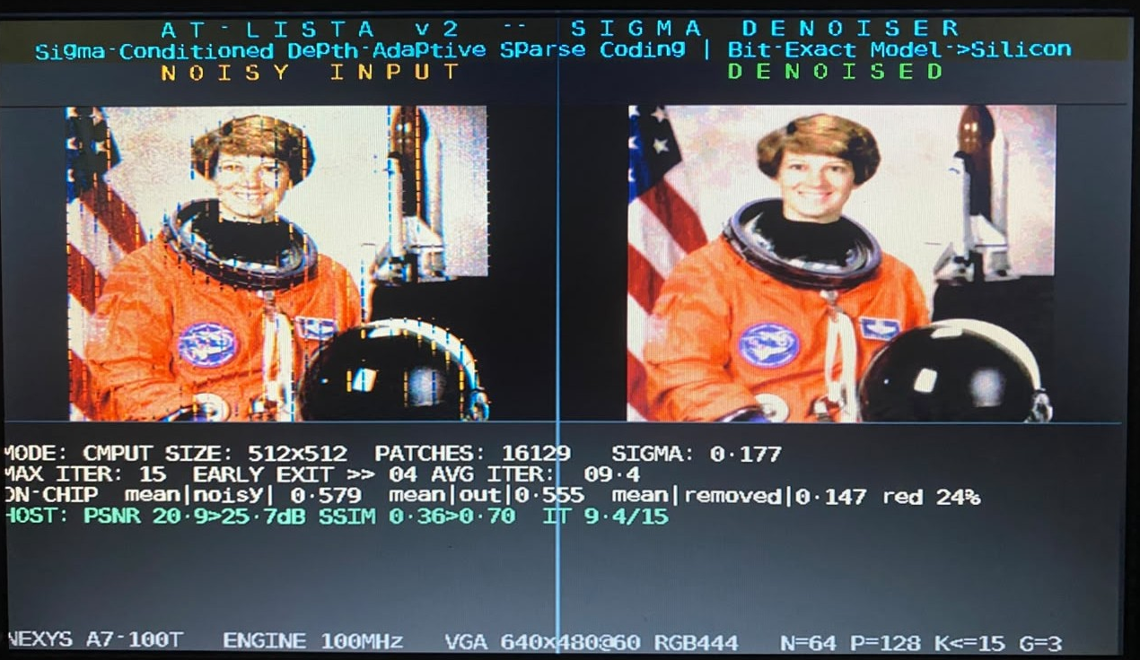
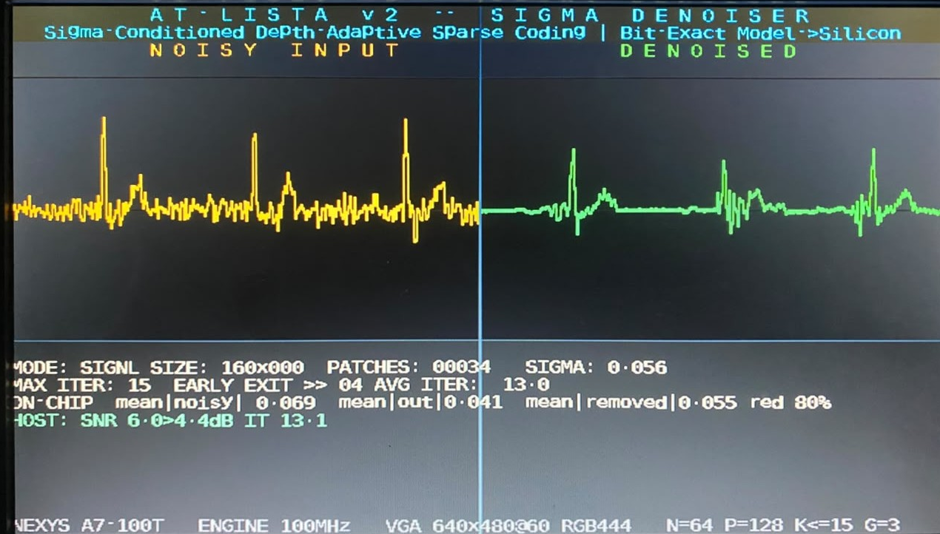
It works: one board, two domains
Figure 2-Natural image (512×512 RGB) — noisy → on-device denoised, live on VGA
Figure3 - ECG signal — same board, same interface, live demo
20.9 → 25.7 dB
image PSNR (+4.8 dB)
0.36 → 0.70
image SSIM
9.4 / 15
avg iters (early-exit)
Live on the Nexys A7-100T
100 MHz · VGA 640×480@60 · ≈63 patches/s
Seeds, source and tooling are shared — a distance learner reproduces this and verifies it on their own board. One illustrative run, not a benchmark.
8
Notes:
[~75 s] Keep the numbers honest and brief. The same board, through one interface, handles two very different signals: a colour image and an ECG trace. On the screen the student sees the noisy input beside the cleaned output, live. For a sense of scale, one representative run lifts image PSNR from about 20.9 to 25.7 decibels (roughly five up) and SSIM from 0.36 to 0.70 — a clearly visible improvement. Say this plainly: this is one illustrative run to show the pipeline end to end, not a benchmarked evaluation against other methods. What matters educationally is that everything — seeds, code, tools — is fixed and shared, so a learner at home reproduces the same result and then verifies it on their own board. If pressed on the numbers, concede they are demonstrative and point to the reproducibility. Transition: so what does this give education, and what is actually new?

Slide 9
Verifiability as pedagogy — and what is new here
Staged learning (no tutor nearby)
▪ Each stage ships with a working reference; the self-test pins the rest.
▪ Rewrite one stage at a time — a failed check names what broke.
▪ Four-milestone rubric (in draft): reproduce the build → replace the golden model → diagnose a seeded precision fault → extend the network by one stage.
What is new — the contribution
▪ Educational: turning a correctness check into a learning outcome and assessment instrument.
▪ Engineering: a complete, open model-to-RTL pipeline on one low-cost board (images + ECG).
▪ Practical: reproducible, student-owned hardware that scales to a shared networked board.
The novelty is in the combination and the reframing of verification as pedagogy — not a new algorithm.
9
Notes:
[~75 s] Two things here: how it teaches, and what is genuinely new. On teaching: the artifact is staged so a lone learner is never stuck. Every stage comes with a working reference, and the self-test holds the rest fixed while the student rewrites just one stage; when a check fails, it names the stage that broke. That same mechanism becomes assessment — a four-milestone rubric from reproducing the build, to replacing the golden model, to diagnosing a planted precision fault, to extending the network. On novelty, be honest and precise. The educational novelty is the real one: reframing an equivalence check as a learning outcome and an assessment tool. The engineering and practical contributions are integrative — a complete open pipeline on cheap owned hardware, reproducible and scalable to a shared board. Say the quiet part out loud: there is no new algorithm here; the contribution is the combination and the reframing. Reviewers accept that when it is stated plainly. Transition: now the limits.

Slide 10
Limitations & what comes next
Limitations
▪ A feasibility / design study — no controlled student-outcome data yet.
▪ Still needs a host PC alongside the board.
▪ The example model is deliberately modest.
What comes next
▪ A controlled study across two cohorts — owned boards vs. one shared instance.
▪ A hosted remote-laboratory deployment over the network.
▪ A more capable model through the same verified flow.
10
Notes:
[~50 s] State the limits before anyone else does; it builds credibility. This is a feasibility and design study — I am showing that the resource works and is reproducible, not yet that it improves learning; there is no controlled outcome data. It still needs a host PC beside the board, so 'ownership' is not zero-infrastructure. And the model is deliberately small. What is next follows directly: a controlled study across two cohorts, one owning boards and one booking a shared instance; a hosted remote-lab version over the network — which needs no new hardware because the host already streams frames; and a larger model through the very same verified flow. Frame limitations as the roadmap, not as apology. Transition: to close.

Slide 11
The takeaway
This is not about building a better FPGA.
It is an educational resource that lets distance learners run authentic embedded machine-learning experiments — on affordable hardware they own, with correctness they can verify for themselves.
Affordable & owned · Full-stack in one project · Bit-exact verified
11
Notes:
[~30 s] Land the one message, slowly, making eye contact — do not rush the finish. If you remember one thing from this talk: this is not a better FPGA. It is an educational resource that puts authentic, verifiable embedded machine-learning experiments within reach of distance learners, on hardware they own. Affordable and owned; full-stack in a single project; and verified bit-for-bit by the student. Pause. Thank the audience and move to questions.

Slide 12
Thank you!
Wimalachandra R.D.M.K.T.
Department of Electrical and Information Engineering, University of Ruhuna
wimalachandrathivanka@gmail.com
12
Notes:
[~10 s + Q&A] Thank you. I'm happy to take questions. Repeat each question back so the whole room hears it, and if a question runs long, offer to continue afterwards. Expect questions on: what 'bit-exact' really proves, whether this counts as formal verification, cost including the host PC, and how you would evaluate learning gains. Answers are in the coaching document.

